Slide 1
IMPORTANT PROTOCOL OF NETWORK LAYERS
By Amit Patel
<number>1

Slide 2
Concept of Data Packet & Datagram
Networks have made information transmission and sharing easier.
The Internet enables us to share information within companies in local networks or worldwide.
While sharing, data is represented by bytes.
The data bytes have a specific format in the OSI networking model since each layer has its specific unit.
The data units also depend on the used protocols or connections.

Slide 3
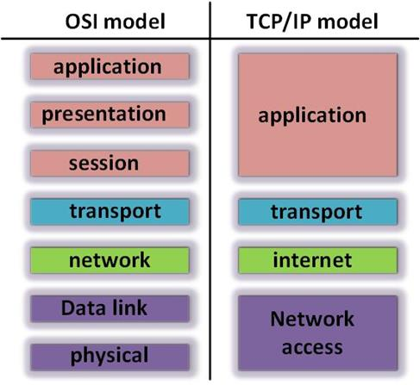

Slide 4
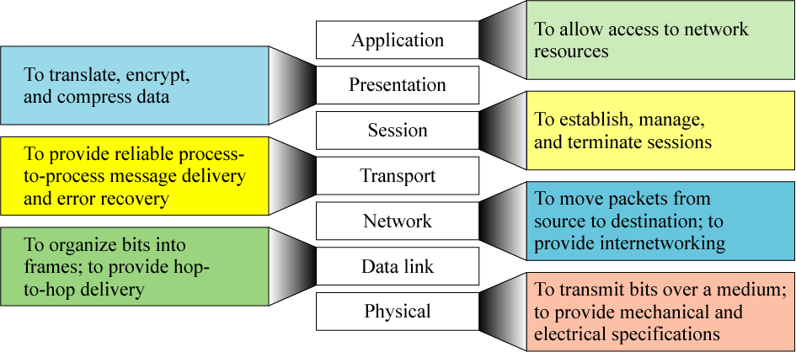

Slide 5
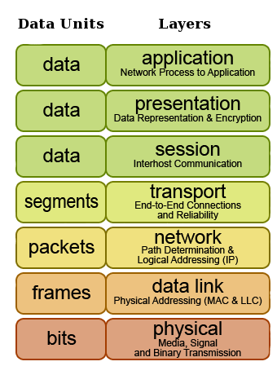
Define : PDU ( Protocol Data Unit)
Data exist at each layer in units called Protocol Data Unit.
Table show the name of PDU at each layer.

Slide 6
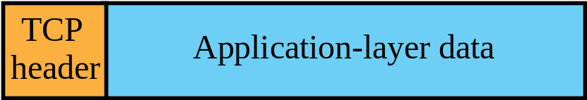
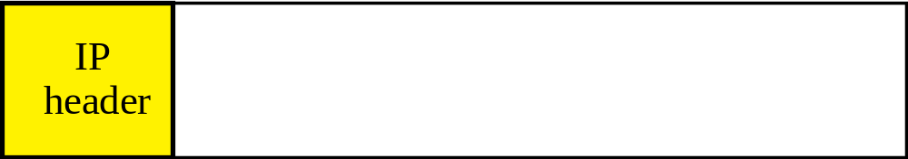

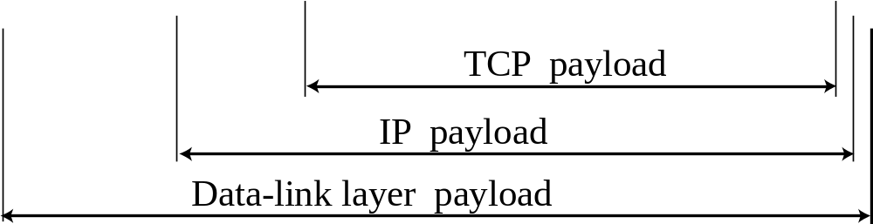
ENCAPSULATION

Slide 7


Slide 8
Data Packet
Data units within the network layer in the OSI model.
While communicating through networks it’s important to send and receive files and information.
The basic unit of communication between a source and a destination in a network is a packet.
Data sent through the network is divided into packets, that are recombined by the destination devices.
Dividing data into packets allows the network to manage different bandwidths, routes, and multiple connected devices that share data and receive packets independently from each other.

Slide 9
Data Packet
It makes it easier to retransmit lost pieces of data or interrupted ones.
Each packet contains a header & trailer.
Header part contain both source and destination IP addresses, a field for the protocol specification, the data, a trailer, protocol version, etc.
The trailer field contains information about error corrections and other flags for the identification.

Slide 10
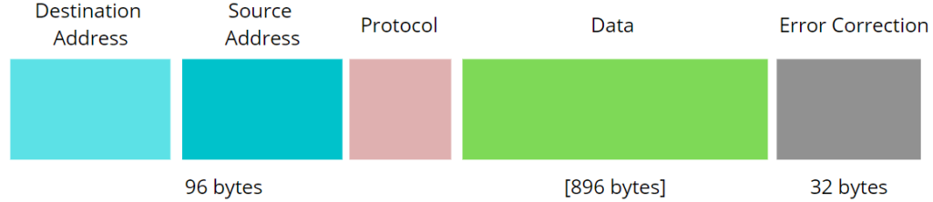

Slide 11
Data Packet
When the user clicks on the button ‘send’, the associated operation executes. The message will go through the OSI model layers until it reaches the network access layer where the packet should be created.
We format the data sent through an email into a packet, containing information about the used protocol, the error correction, IP addresses of the sender and the receiver (source and destination, respectively), as well as the email text:

Slide 12
Datagram
The transport layer uses datagram as a unit of transfer data.
Data transmitted in a network is divided into smaller parts called datagrams.
In a datagram, we divide data frequently and transmitted from source to destination without a predefined route.
We also can’t guarantee the order of delivery to the receiver end.
Used in UDP.
Making them carry less information since they don’t need to have a response message from the destination.

Slide 13
Datagram
A datagram comprises a header, IP addresses of destination and source, and the data.
The problem with datagram is it can’t manage subsequent or prior data communication.
Also for a single transfer, a datagram can accommodate up to 65535 bytes of data which is very small.
In the case we sent an email using the UDP protocol, there will be no packets but datagrams.
The information transmitted would be in the following figure:

Slide 14
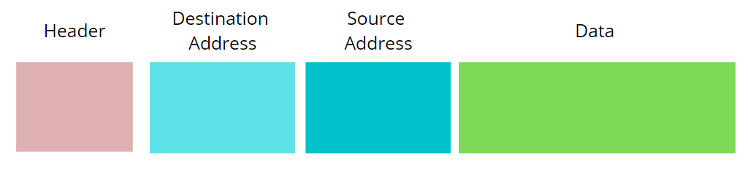

Slide 15
Protocol Suite
A protocol suite is a collection of protocols that are designed to work together.
Why We require Protocol Suite?
It is possible to write a single protocol that takes data from one computer application and sends it to an application on another computer
The problem with this approach is that it very inflexible, as any changes require changing the entire application and protocol software.

Slide 16
Continue…
Actual communication is defined by various communication protocols.
Network protocols include mechanisms for devices to identify and make connections with each other, as well as formatting rules that specify how data is packaged into messages sent and received.
Some protocols also support message acknowledgement and data compression designed for reliable and/or high-performance network communication.

Slide 17
Continue..
Protocols can be implemented either in hardware or software or a mixture of both.
Protocol determines following
  How sending device indicate that it was finished sending a message.
  How receiving device indicate that it was received a message
  How error checking, data compression, flow control should be done during data transmission.

Slide 18
Presentation Layer Services
Data Translation
Encryption
Decryption
Compression
All above services is provided by using special protocol for it or for some services it take services of various protocol of Application layer.

Slide 19
Continue..
Each communication protocol has three aspects…
  Syntax - Data format and coding
  Semantics - Control information and error handling
  Timing - Speed matching and sequencing
Many protocols were developed to provide and support data communications.
They form a communication architecture, sometimes referred as "protocol stack".
For example TCP/IP family of protocols are often referred to as "TCP protocol stack".

Slide 20
HTTP
Hyper Text Transfer Protocol.
Used to access the data on the World Wide Web (www).
Used to transfer the data in the form of plain text, hypertext, audio, video, and so on.
Why HyperText Transfer Protocol? : because of its efficiency that allows us to use in a hypertext environment where there are rapid jumps from one document to another document.

Slide 21
HTTP
HTTP is similar to SMTP as the data is transferred between client and server.
The HTTP differs from the SMTP in the way the messages are sent from the client to the server and from server to the client. SMTP messages are stored and forwarded while HTTP messages are delivered immediately.

Slide 22
Features of HTTP
Connectionless protocol:
HTTP client initiates a request and waits for a response from the server.
When the server receives the request, the server processes the request and sends back the response to the HTTP client after which the client disconnects the connection.
The connection between client and server exist only during the current request and response time only.

Slide 23
Features of HTTP
Media independent: HTTP protocol is a media independent as data can be sent as long as both the client and server know how to handle the data content.
Stateless: HTTP is a stateless protocol as both the client and server know each other only during the current request. Due to this nature of the protocol, both the client and server do not retain the information between various requests of the web pages.

Slide 24
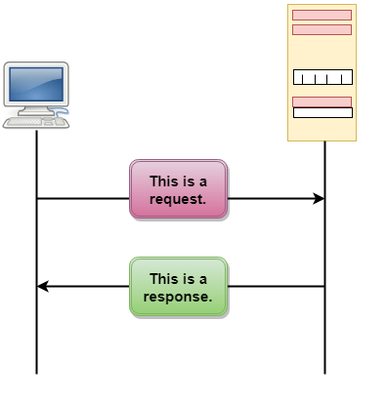
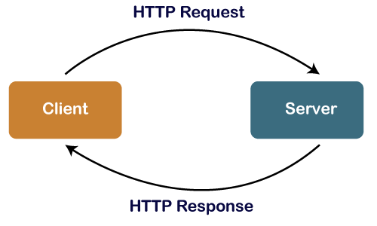

Slide 25
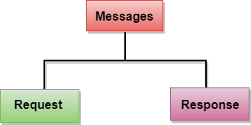
Types of HTTP Message

Slide 26
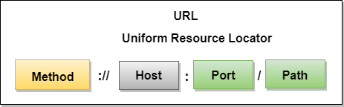
URL
Uniform Resource Locator
A client that wants to access the document in an internet needs an address and to facilitate the access of documents, the HTTP uses the concept of Uniform Resource Locator (URL).
The Uniform Resource Locator (URL) is a standard way of specifying any kind of information on the internet.
The URL defines four parts: method, host computer, port, and path.

Slide 27
URL
Method: The method is the protocol used to retrieve the document from a server. For example, HTTP.
Host: The host is the computer where the information is stored, and the computer is given an alias name. Web pages are mainly stored in the computers and the computers are given an alias name that begins with the characters "www". This field is not mandatory.
Port: The URL can also contain the port number of the server, but it's an optional field. If the port number is included, then it must come between the host and path and it should be separated from the host by a colon.

Slide 28
URL
Path: Path is the pathname of the file where the information is stored. The path itself contain slashes that separate the directories from the subdirectories and files.

Slide 29
HTTPS
Hypertext Transfer Protocol Secure.
The HTTP protocol does not provide the security of the data, while HTTPS ensures the security of the data. Therefore, we can say that HTTPS is a secure version of the HTTP protocol.
This protocol allows transferring the data in an encrypted form.
The use of HTTPS protocol is mainly required where we need to enter the bank account details.

Slide 30
HTTPS
The HTTPS protocol is mainly used where we require to enter the login credentials. In modern browsers such as chrome, both the protocols, i.e., HTTP and HTTPS, are marked differently.
To provide encryption, HTTPS uses an encryption protocol known as Transport Layer Security, and officially, it is referred to as a Secure Sockets Layer (SSL).
This protocol uses a mechanism known as asymmetric public key infrastructure, and it uses two different keys which are given below:

Slide 31
HTTPS
Private key:
This key is available on the web server, which is managed by the owner of a website.
It decrypts the information which is encrypted by the public key.
Public key:
This key is available to everyone. It converts the data into an encrypted form.

Slide 32
HTTP Vs HTTPS
The major difference between the HTTP and HTTPS is the SSL certificate. The HTTPS protocol is an extended version of the HTTP protocol with an additional feature of security.
This additional feature of security is very important for those websites which transmit sensitive data such as credit card information.

Slide 33
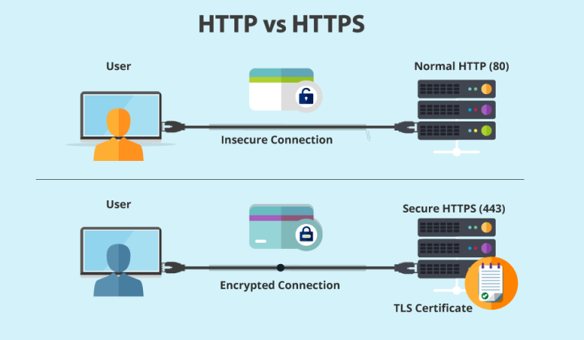
HTTP Vs HTTPS

Slide 34
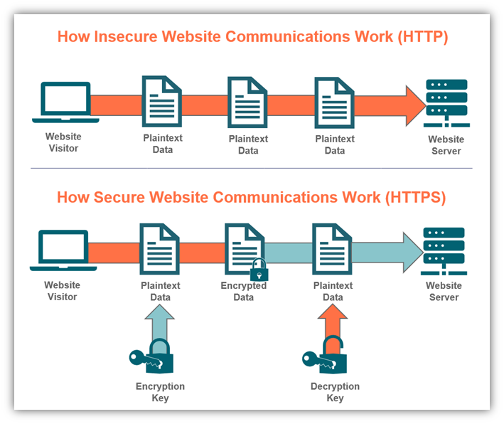

Slide 35
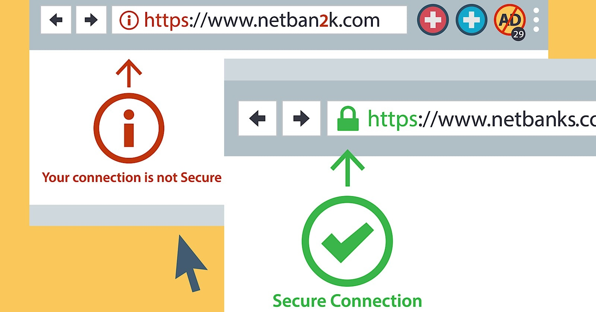

Slide 36
HTTP Vs HTTPS
The HTTPS protocol is secured due to the SSL protocol. The SSL protocol encrypts the data which the client transmits to the server.
If someone tries to steal the information which is being communicated between the client and the server, then he/she would not be able to understand due to the encryption.
This is the main difference between the HTTP and HTTPS that the HTTP does not contain SSL, whereas the HTTPS contains SSL that provides secure communication between the client and the server.

Slide 37
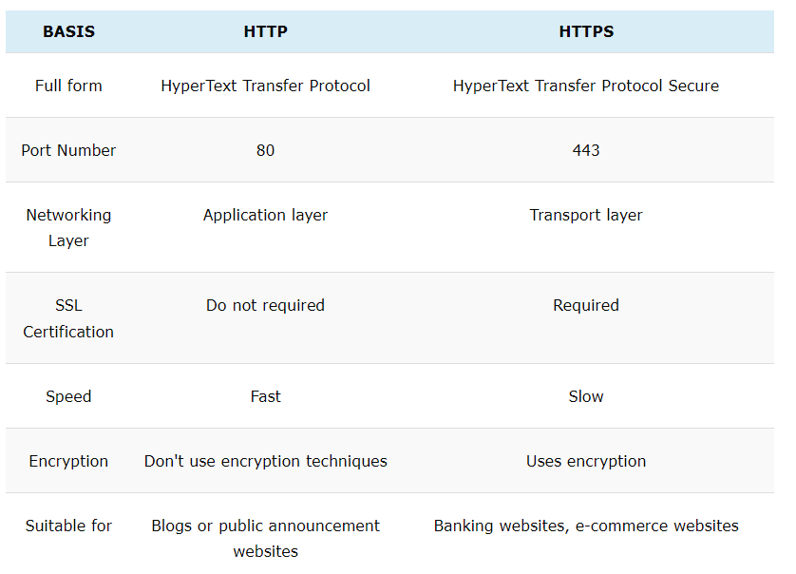

Slide 38
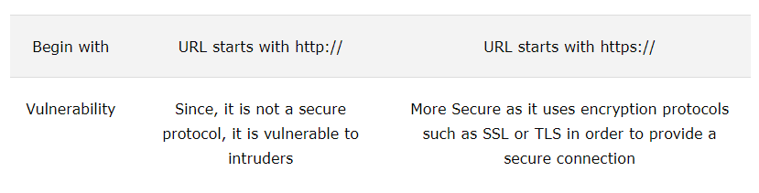

Slide 39
FTP
File Transfer Protocol
Protocol provided by TCP/IP used for transmitting the files from one host to another.
Used for transferring the web page files from their creator to the computer that acts as a server for other computers on the internet.
Used for downloading the files to computer from other servers.

Slide 40
Objectives of FTP
It provides the sharing of files.
It is used to encourage the use of remote computers.
It transfers the data more reliably and efficiently.

Slide 41
Objectives of FTP
It provides the sharing of files.
It is used to encourage the use of remote computers.
It transfers the data more reliably and efficiently.

Slide 42
Why We Require FTP ?
Although transferring files from one system to another is very simple and straightforward, but sometimes it can cause problems.
For example, two systems may have different file conventions.
Two systems may have different ways to represent text and data. Two systems may have different directory structures.
FTP protocol overcomes these problems by establishing two connections between hosts.
One connection is used for data transfer, and another connection is used for the control connection.

Slide 43
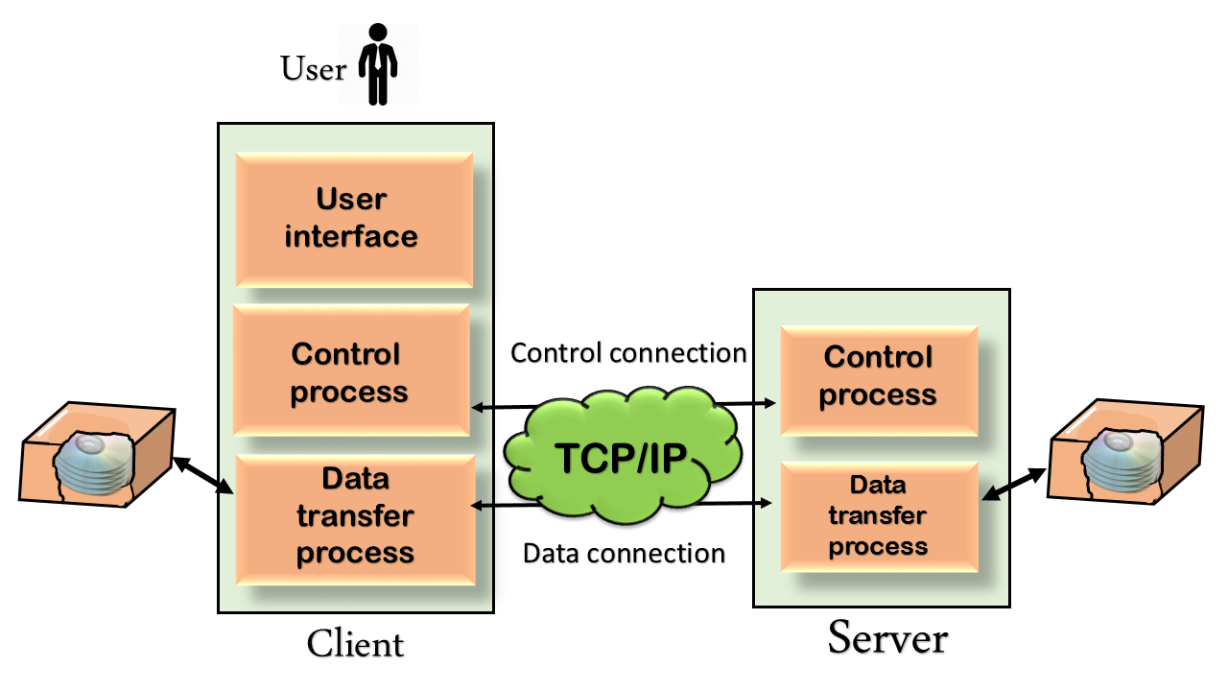
Why We Require FTP ?

Slide 44
FTP
The above figure shows the basic model of the FTP.
The FTP client has three components: the user interface, control process, and data transfer process. The server has two components: the server control process and the server data transfer process.

Slide 45
Type of FTP Connections
Control Connection:
Through control connection, we can transfer a line of command or line of response at a time.
The control connection is made between the control processes.
The control connection remains connected during the entire interactive FTP session.

Slide 46
Type of FTP Connections
Data Connection:
The Data Connection uses very complex rules as data types may vary.
The data connection is made between data transfer processes.
The data connection opens when a command comes for transferring the files and closes when the file is transferred.

Slide 47
How FTP Work?
It uses TCP services.
It needs two TCP connections.
One is a Control connection, and another is a Data connection.
For control connection, it uses well-known port 21, and for data connection, it uses well-known port 20.

Slide 48
Control Connection
A server site control connection uses a well-known port 21.
There are two steps to establish a control connection:
  The server issues a passive open on the well-known port 21 and waits for the client.
  After severing issues passive open, the client issue active open using an ephemeral port.
This control connection remains open throughout the process.
Since the user and the server uses the interactive connection for communication, their service used by internet protocol minimizes the delay.

Slide 49
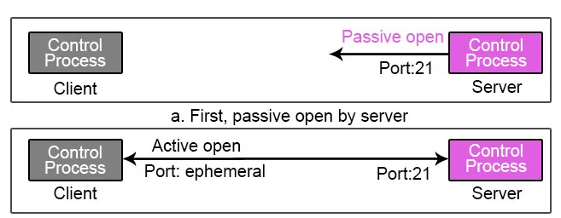

Slide 50
Data Connection
At the server-side, the data connection uses well-known port 20.
There are three steps to establish a data connection:
  Using ephemeral port client issues a passive open. This step must be done by the client, not the server because the client wants to transform the file.
  Using the PORT command client sends this port number to the server.
  When the server receives this port number from the client, it issues active open using well-known port 20.

Slide 51
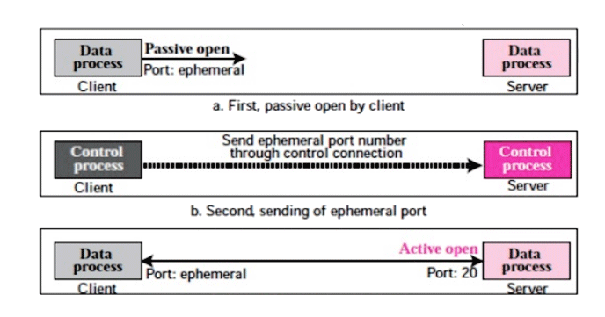

Slide 52
Communication
Both the client and the server, which runs on two different systems, must be communicated for transforming data.
For communication, it uses two approaches, i.e. communication over control connection and communication over a data connection.

Slide 53
Command Processing
To establish communication between the client system and the server system, FTP uses a control connection.
During this process, the client sends commands to the server, and in return, the server sends a response to the client.

Slide 54
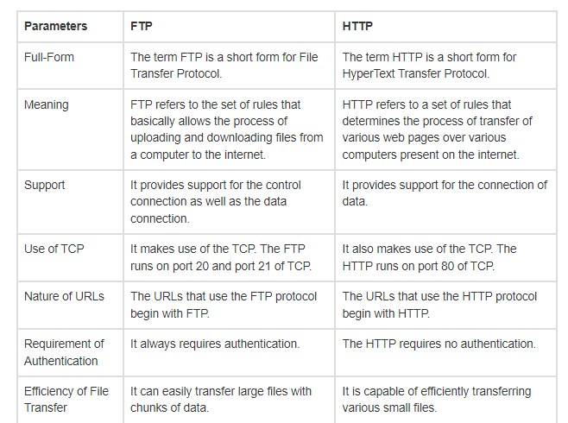

Slide 55
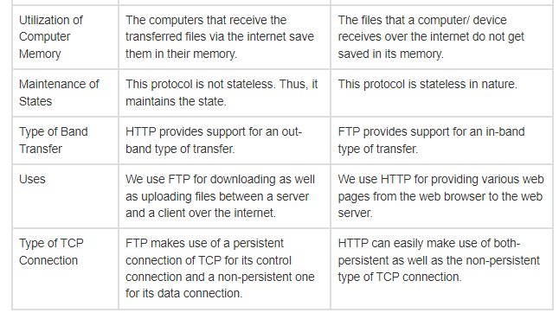

Slide 56
Telnet
TELNET means TELecommunication NETwork
Telnet is a simple, text-based program that allows you to connect to remote computer on the Internet using a username and password.
Provides capability to locg onto a remote computer. Hense it is also known as remote login.
To use Telnet to access a device you have to actually have access permission.
This features allows PCs to communicate successfully with remote pc, help user to tap into internet computers and access public files.
Telnet uses TCP port 23

Slide 57
Continue…..
Telnet session is established by using telnet client software (puTTy).
The user request session to be established with remote host by providing its host name of IP Address.
The telnet client software locates the host over the internet and establish a remote login session to that host.
The only potensial down side is you must know the computer you are logged onto and the remote computer must also grant you access.
When you connect, your computer acts as if your keyboard is attached to the remote computer.

Slide 58
TelNet
When you type any command, it is executed on the remote computer.
You can observer on your monitor what is taking place on the remote computer when telnet session is going on.
The computer on which you are working by sitting in front of it is called local computer. The telnet connection is to be initialized from this machine.
The machine being connected to, which grant the connection is referred to as the remote computer. It is also known as telnet server.

Slide 59
Characteristics
Bidirectional: That means Telnet is not one-way; it can be used to send and receive information.
Interactive: That means Telnet basically expects a live user on one end of the line. Telnet is not usually used for computers to talk autonomously with each other, but was built from the ground up to be human-readable.
Text-oriented: Telnet is a text-only protocol; you won’t see graphics or fancy images while working with Telnet, nor will you be able to transfer files with Telnet.

Slide 60
Telnet
TELecommunication NETwork.
Network protocol used on the Internet or local area network (LAN) connections.
It is a network protocol used on the Internet or local area networks to provide a bidirectional interactive communications facility.
Typically, telnet provides access to a command-line interface on a remote host via a virtual terminal connection which consists of an 8-bit byte oriented data connection over the Transmission Control Protocol (TCP).
The user’s computer, which initiates the connection, is referred to as the local computer.

Slide 61
Telnet
The computer being connected to, which accepts the connection, is referred to as the remote computer.
The remote computer can be physically located in the next room, the next town or in another country.
Allows a user to log in on any other computer on the network.
We can start a remote session by specifying a computer to connect to. From that time until we finish the session, anything we type is sent to the other computer.
The Telnet program runs on the computer and connects your PC to a server on the network.

Slide 62
Telnet
We can then enter commands through the Telnet program and they will be executed as if we were entering them directly on the server console.
This enables to control the server and communicate with other servers on the network.
To start a Telnet session, we must log in to a server by entering a valid username and password. Telnet is a common way to remotely control Web servers.

Slide 63
Telnet
Telnet can be used to connect to virtually any machine that listens on ports.
In other words, you can connect to any machine that has certain ports open.
Once connected to a machine, you need to issue UNIX based commands to interact with the remote service.
Command Prompt> Telnet
Command Prompt> open (somedomain.com or ip address) 80

Slide 64
Application Layer Protocol
Provide Following Service
File transfer, access and management
Mail services
Directory services.
Print Services
Support for network standard virtual terminal.

Slide 65
Application Layer Protocol
To Provide service it uses various protocol like
SMTP : For Mail Services
POP : For Mail Service
DNS: For Directory Services

Slide 66
SMTP
Simple Mail Transport Protocol
Specifies how mail should be delivered from one system to another.
Used : To send message from email client to SMTP server.
Take the service of TCP/IP protocol that specifies how computers exchange electronic mail.
SMTP uses TCP port number 25 for his service.
E-mail is delivered from source to destination by having the source machine established a TCP connection to port 25 of the destination machine

Slide 67
SMTP
It works with post office protocol (POP).
The sending SMTP server discovers the IP address of the recipient SMTP server using the domain name part of the email address.
SMTP server is registered on the DNS using “ Mail Exchanger” (MX) records.

Slide 68
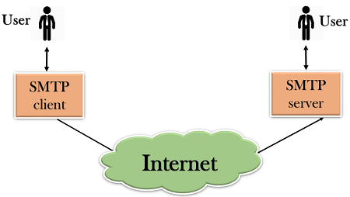
SMTP
To send a mail, a system must have a client MTA, and to receive a mail, a system must have a server MTA.
SMTP transfers this message from client MTA to server MTA.
SMTP uses commands and responses to transfer the message between an MTA client and MTA server

Slide 69
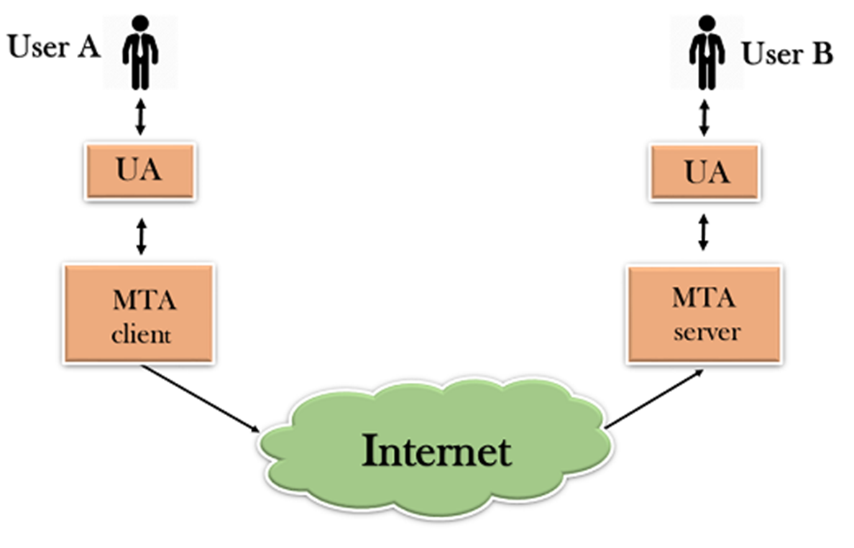
SMTP
First, we will break the SMTP client and SMTP server into two components such as user agent (UA) and mail transfer agent (MTA).
The user agent (UA) prepares the message, creates the envelope and then puts the message in the envelope.
The mail transfer agent (MTA) transfers this mail across the internet.

Slide 70
HOW SMTP WORK
Before transmission , sender SMTP establishes the two way transmission channel to a receiver SMTP.
The receiver SMTP may be either destination or intermediate.
The “smtp” command are generated by sender SMTP and sent to a recipient SMTP.
SMTP replies are sent from destination to source SMTP.
After communication channel is established , the SMTP sender send a MAIL command indicating the sending a mail.
When the SMTP Receiver accepts the mail, it respond with OK reply otherwise respond with rejecting that recipient.

Slide 71
POP
Post Office Protocol.
Use: To retrieving mail from mailbox on computing device.
When the message is sent, then SMPT is used to deliver the message from the client to the server and then to the recipient server.
Designed to allow the recipient to download their mail to their email client at their own convenience.
But the message is sent from the recipient server to the actual machine with the help of the Message Access Agent.
The Message Access Agent contains two types of protocols, i.e., POP3 and IMAP.

Slide 72
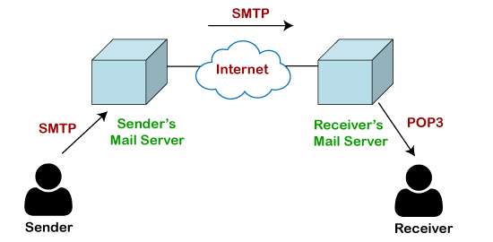

Slide 73
POP
The server receives the mail on behalf of its clients.
A POP3 server stores messages for each user until the user connects to download and read them using a POP3 client such as Microsoft Outlook.
To retrieve a message from a POP3 server, a POP3 client establishes a Transmission Control Protocol (TCP) session using TCP port 110, identifies itself to the server, and then issues a series of POP3 commands:

Slide 74
HOW POP WORK?
When a user checks for new email, the client will connect to the POP3 server.
The email client then supplies its username and password to the server for authentication.
Once connected, the client issues a series of text-based commands to retrieve all email messages.
It then stores these downloaded messages on the user’s local system as new emails, deletes the server copies and disconnects from the server.

Slide 75
HOW POP WORK?
By default, the server emails are deleted once they are retrieved.
As a result, the emails are tied to that particular machine and it would not be possible to access the same emails from an email client on another machine.
The user could get around this issue by configuring the email client settings to leave a copy of the emails on the server.
POP frees up mailbox space on the server because emails and attachments are downloaded and deleted at server-end whenever the email client checks for new mails.

Slide 76
HOW POP WORK?
Offline email messages stored in the user’s computer do not have mailbox size limitations except for the hard drive storage capacity of the PC.
One drawback of POP3 mail accounts is that it is difficult for the user to export mails if they decide to switch email programs or computer systems.

Slide 77
Advantage
Emails are downloaded to the user’s computer. Messages can be read when user is offline.
Opening attachments is quick and easy as they are already downloaded.
Less server storage space required; all emails are stored on local machine.
Storage capacity of emails limited by the size of your hard disk.
Very popular, easy to configure and use.

Slide 78
DNS
Full Name: Domain Name System
Use: Translates Internet domain and host names to IP Address.
Database of domain names for easier look up with its IP address.
DNS automatically converts the names we type in our Web browser address bar to the IP addresses of Web servers hosting those sites.
DNS is like a phone book for the Internet Domain Address in which it is HUMAN-Friendly to translate it to an IP Address that computer understand well.

Slide 79
DNS
For example:
Google.com (domain name) translated to ip address 74.125.131.106!
DNS implements a distributed database to store this name and address information for all public hosts on the Internet.
The DNS database resides on a hierarchy of special database servers.
DNS is a directory service that provides a mapping between the name of a host on the network and its numerical address.
DNS is required for the functioning of the internet.

Slide 80
DNS
All public Web sites run on servers connected to the Internet with Public( Live ) IP Address.
The Web servers at google.com, for example, have addresses like 74.125.131.106 .
Although people can type address information like http://207.241.148.80/ into their Web browser to visit sites, being able to use proper names like http://www.google.com/ is much more practical.

Slide 81
DNS
DNS servers are the computers designated to store DNS database records (names and addresses), while clients of the DNS include PCs, phones and other devices of end users.
DNS servers also interface with each other, acting as clients to each other when needed.
DNS uses a Client Server Network architecture.
Organized in Tree structure.
Each node in a tree has a domain name, and a full domain name is a sequence of symbols specified by dots.

Slide 82
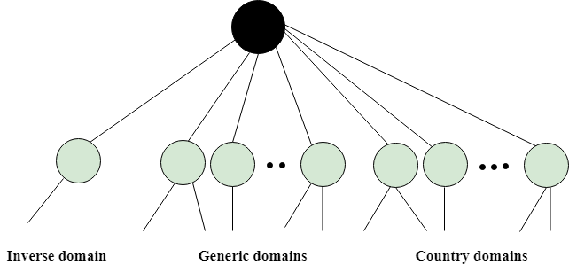

Slide 83
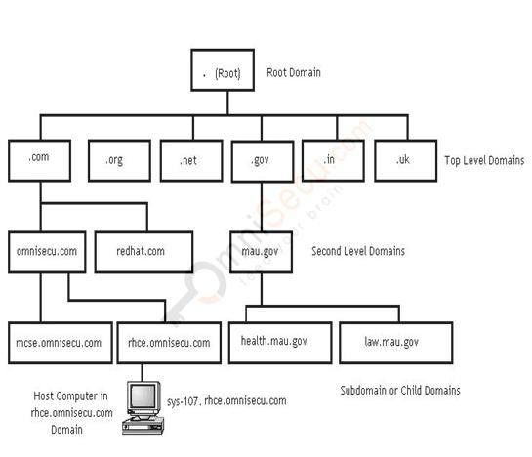
DNS Server Hierarchy

Slide 84
DNS
For the Internet, so-called root name servers reside at the top of the DNS hierarchy.
The Internet root name servers manage DNS server information for the Web's Top Level Domain (TLD) (like ".com" and ".uk"),
specifically the names and IP addresses of the original DNS servers responsible for answering queries about each TLD individually.
Servers at the next lower level of the DNS hierarchy track second-level domain names and addresses (like “about. COM")
Additional levels manage Web domains (like "compnetworking.about.com").

Slide 85
Generic Domain
It defines the registered hosts according to their generic behavior.
Each node in a tree defines the domain name, which is an index to the DNS database.
It uses three-character labels, and these labels describe the organization type.

Slide 86
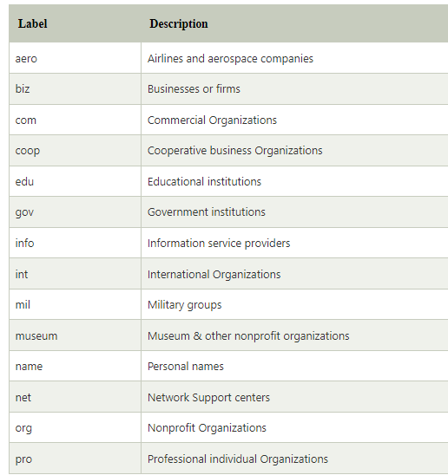

Slide 87
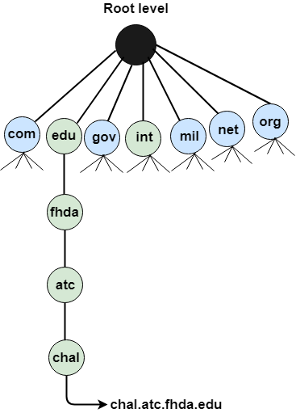

Slide 88
DNS
Country Domain
The format of country domain is same as a generic domain, but it uses two-character country abbreviations (e.g., us for the United States) in place of three character organizational abbreviations.
Inverse Domain
The inverse domain is used for mapping an address to a name. When the server has received a request from the client, and the server contains the files of only authorized clients. To determine whether the client is on the authorized list or not, it sends a query to the DNS server and ask for mapping an address to the name.

Slide 89
Working of DNS
DNS is a client/server network communication protocol. DNS clients send requests to the. server while DNS servers send responses to the client.
Client requests contain a name which is converted into an IP address known as a forward DNS lookups while requests containing an IP address which is converted into a name known as reverse DNS lookups.
DNS implements a distributed database to store the name of all the hosts available on the internet.

Slide 90
Working of DNS
If a client like a web browser sends a request containing a hostname, then a piece of software such as DNS resolver sends a request to the DNS server to obtain the IP address of a hostname.
If DNS server does not contain the IP address associated with a hostname, then it forwards the request to another DNS server.
If IP address has arrived at the resolver, which in turn completes the request over the internet protocol.

Slide 91
E-mail
Full Form: Electronic Mail.
Definition: E-mail is a method of exchanging digital messages over a network from one user to anothers.
E-mail is text-based mail consisting of lines of text and include attachments such as audio messages, pictures and documets.
Modern email operates across the internet and other computer networks.

Slide 92
Features of E-mail
Sent to one person or more than one person at the same time.
Communication via e-mail does not require physical presence of the recipient.
Fast way to communication with people as compared to postal office.
Sent at any time of the day.
A copy of e-mail message that the sender has sent is available on the sender’s computer for later reference.
The recipient of e-mail can read the mail, forward it or reply back. The recipient can also store the email or delete it.

Slide 93
E-mail Address
To use e-mail, a user must have an e-mail address.
E-mail address contains all information required to send or receive a message from anywhere in the world.
An e-mail address consists of two parts separated by two parts separated by @ symbol.
The first part is user_name and second part is host computer name.

Slide 94
E-mail Address
The e-mail address may looks like
    patelamitrp@yahoo.com
Where:
  patelamitrp is user name
  Yahoo.com is host computer name or domain name, is the mail box where finally the mail will be delivered.

Slide 95
E-mail Message Format
The e-mail message consists of two parts.
    Header
    Body
The header contain information about the message such as:
  From: Sender’s E-mail address.
  To: Recipient’s E-mail address.
  Date: When E-mail was sent.
  Subject: The topic of the message.

Slide 96
E-mail Message Format
  Cc: Address where carbon copy of the same message with be sent. The recipients of e-mail can see all e-mail addresses to which the copies have been sent.
  Bcc: Address where Blind Carbon Copies of the same e-mail sent. The receipient of e-mail don’t know that the same e-mail has been sent to other e-mail addresses.
  The size of the e-mail.
  Body contain the text of the messages and any attachment to be sent.

Slide 97
E-mail Services
There are two kinds of E-mail services
  Application Based
  Web Based
Application Based:
  It is installed onto the user’s computer.
  The mail is stored on the user’s computer.
  For using the application based e-mail, the user use a program like Microsoft Outlook.

Slide 98
E-mail Services
Web Based:
  Web based or Webmail appear in web browser’s window.
  It can be accessed by user from any internet connected computer anywhere in the world.
  It is not stored in user’s computer.
  Hotmail, yahoo and gmail provide free e-mail accounts.
  For example: patelamitrp@yahoo.com is webmail address.

Slide 99
E-mail Protocol
E-mail uses the services of following protocols.
  SMTP ( Simple Mail Transfer Protocol ) : Used to send e-mail from the client to server and from server to another server.
  POP3 ( Post Office Protocol ) : Used by client for application based e-mail to access mail from the server.
  IMAP ( Internet Message Access Protocol ): Used by client for web based e-mail to access mail on server.

Slide 100
SMTP
Full Form: Simple Mail Transfer Protocol.
It is a standard protocol used for sending e-mail efficiently and reliably over the internet.
SMTP is application level protocol.
SMTP is connection oriented protocol.
SMTP is text based protocol.
It handles exchange of messages between e-mail servers over TCP/IP network.
Apart from transferring e-mail, SMPT also provides notification regarding incoming mail.

Slide 101
SMTP
When you send e-mail, your e-mail client sends it to your e-mail server which further contacts the recipient mail server using SMTP client.
These SMTP commands specify the sender’s and receiver’s e-mail address, along with the message to be send.
The exchange of commands between servers is carried out without intervention of any user.
In case, message cannot be delivered, an error report is sent to the sender which makes SMTP a reliable protocol.

Slide 102
MIME
Full Name: Multipurpose Internet Mail Extensions.
It is an extension of the original Internet e-mail protocol that lets people use to exchange different kinds of data files on the Internet: audio, video, images, application programs.
It support:
  Text in character set other than ASCII.
  Non-text attachments.
  Message bodies with multiple parts.

Slide 103
POP3
Full Form: Post Office Protocol.
It is generally used to support a single client. There are several versions of POP but the POP 3 is the current standard.
POP is an application layer internet standard protocol.
Since POP supports offline access to the messages, thus requires less internet usage time.
POP does not allow search facility.
In order to access the messaged, it is necessary to download them.
It allows only one mailbox to be created on server.

Slide 104
IMAP
Full Form: Internet Mail Access Protocol.
It was first proposed in 1986.
There exist five versions of IMAP as follows:
  Original IMAP
  IMAP2
  IMAP3
  IMAP2bis
  IMAP4

Slide 105
IMAP
IMAP allows the client program to manipulate the e-mail message on the server without downloading them on the local computer.
The e-mail is hold and maintained by the remote server.
It enables us to take any action such as downloading, delete the mail without reading the mail.
It enables us to create, manipulate and delete remote message folders called mail boxes.
IMAP enables the users to search the e-mails.
It allows concurrent access to multiple mailboxes on multiple mail servers

Slide 106
How E-mail Work?
E-mail works on client-server model.
The client connect to e-mail server when the user want to send, check or receive e-mail.
  The client connect to the server on two TCP/IP Port.
  SMTP on port 25
  POP3 on port 110 or IMAP on Port 143.
SMTP server accepts outgoing e-mail form the client.
SMTP Server check the e-mail address at which e-mail has to be delieverd.

Slide 107
How Email Works?
  If the recipient e-mail client resides on the same SMTP server , then the e-mail is sent to the local POP or IMAP Server.
  Otherwise, e-mail is sent to another SMTP server so that the it reach the recipient e-mail client’s SMTP Server.
POP3 stores e-mail for a client on a remote server. When the client gets connected to server, the e-mail message are downloaded from POP3 server to client’s computer.

Slide 108
How E-mail Works?
IMAP also store e-mail on remote server. However, e-mail message are not downloaded to the client’s computer. The user directly manipulate e-mail on the e-mail server.

Slide 109
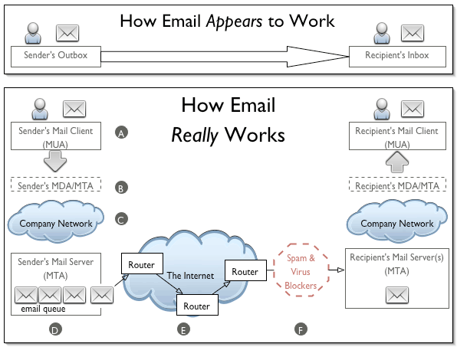

Slide 110
Component of Email Service
Email Client or Mail User Agent (UA)
An email client or a user agent is a software application or a program that is used to compose and read the email. On the sender side, it is used to compose and send the email. On the receiver side, it is used to read and reply to the received email. MS Outlook, macOS Mail, /bin/mail, Alpine, and Gmail are some examples of email client programs.

Slide 111
Component of Email Service
Mail Submission Agent (MSA)
MSA takes emails from the user agent and delivers them to a mail transfer agent. MSA was developed later in the email system. It was invented to reduce some burden from MTA.
If implemented, MSA sits between a user agent and a mail transfer agent. It secures the connection between UA and MTA by implementing encryption and authentication. Besides this, it can perform many more tasks based on its configuration, such as rewriting the email header and performing security checks.

Slide 112
Component of Email Service
Mail Delivery Agent (MDA)
MDA takes emails from MTA and delivers them to the message store. MDA does the opposite of MSA. Just like MSA, it was also invented to reduce the burden from MTA. Since MDA delivers emails to the local system, it is also known as LDA (local delivery agent). Same as MSA, several additional functionalities such as virus scanning and spam email filtering can be configured on MDA.
MSA and MDA are part of MTA. Whether they will be used or not depend on several factors such as volume of emails and security requirement. But if they are configured in MTA, we have to configure the user agent to communicate with them instead of MTA.

Slide 113
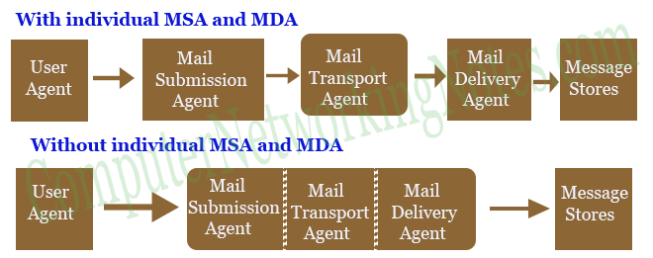

Slide 114
EMAIL
Step A: Sender creates and sends an email
The originating sender creates an email in their Mail User Agent (MUA) and clicks 'Send'. The MUA is the application the originating sender uses to compose and read email, such as Eudora, Outlook, etc.
Step B: Sender's MDA/MTA routes the email
The sender's MUA transfers the email to a Mail Delivery Agent (MDA). Frequently, the sender's MTA also handles the responsibilities of an MDA.
The MDA/MTA accepts the email, then routes it to local mailboxes or forwards it if it isn't locally addressed.
In our diagram, an MDA forwards the email to an MTA and it enters the first of a series of "network clouds," labeled as a "Company Network" cloud.

Slide 115
EMAIL
Mail Transport Agent (MTA)
MTA is the backbone of an email system. It takes emails from UA or MSA, understands the recipient's address, and delivers them to their destination. MTA uses Simple Mail Transport Protocol (SMTP) for its operation.

Slide 116
EMAIL
Essential MTA operations are listed below.
Outgoing mail operation
Receive outgoing emails from UA and MSA
Understand the recipient’s addresses
If require, rewrite the addresses
Perform a DNS MX lookup to resolve the recipient’s address
If the recipient is directly accessible, forward the email to MDA
If the recipient is not directly accessible, forward the email to the next responsible MTA

Slide 117
EMAIL
Incoming mail operation
Receive incoming mails from other MTA
Understand the recipient’s addresses
If the recipient belongs to it, perform a virus scan and forward the email to MDA
If the recipient does not belong to it, forward the email to the next responsible MTA

Slide 118
EMAIL
Message stores
The message store is the location of the recipient's server or the computer where messages are delivered by MDA. Depending on the setting, messages can be stored in several formats, such as mbox and Maildir.
The mbox format
In this format, all messages are stored in a single file. To separate messages from each other, a special line is used between two messages.

Slide 119
EMAIL
The Maildir format
In this format, each message is stored in a separate file. This method is more convenient but it creates a lot of files.
The Maildir or the mbox format is convenient if the volume of email is low. These methods are usually used in small office networks or home networks. In a large network, a more advanced method such as a database is used to store the messages.

Slide 120
EMAIL
Access Agent (AA)
An access agent takes messages from the message store and delivers them to the email client or the user agent on the local device such as PC, laptop, tablet, smartphone, etc. Two protocols known as POP3 and IMAP are used by access agents to retrieve emails from the message store.

Slide 121
EMAIL
POP3
POP3 is a one-way protocol. It can only download messages in email clients from the message store. It does not tell the message box what users do with downloaded messages. Since the message store does not know what users do with the downloaded messages, it keeps locally stored messages intact or simply deletes them once they are downloaded.

Slide 122
EMAIL
POP3
POP3 is a one-way protocol. It can only download messages in email clients from the message store. It does not tell the message box what users do with downloaded messages. Since the message store does not know what users do with the downloaded messages, it keeps locally stored messages intact or simply deletes them once they are downloaded.

Slide 123
EMAIL
IMAP
IMAP is a two-way protocol. Besides downloading messages from the message store, it also updates the message store about the action which user performs on the downloaded messages. Since the message store knows the action which user takes on the downloaded messages, it automatically performs that action on locally stored messages to keep a similar copy of messages at both locations.
This protocol uses advanced techniques to download messages in email clients from the message store. It only downloads the header of mail. It downloads contents and attachments of mail only when the user reads the mail.

Slide 124
EMAIL
In our diagram, an MDA forwards the email to an MTA and it enters the first of a series of "network clouds," labeled as a "Company Network" cloud.
Step C: Network Cloud
An email can encounter a network cloud within a large company or ISP, or the largest network cloud in existence: the Internet. The network cloud may encompass a multitude of mail servers, DNS servers, routers, lions, tigers, bears (wolves!) and other devices and services too numerous to mention. These are prone to be slow when processing an unusually heavy load, temporarily unable to receive an email when taken down for maintenance, and sometimes may not have identified themselves properly to the Internet through the Domain Name System (DNS) so that other MTAs in the network cloud are unable to deliver mail as addressed. These devices may be protected by firewalls, spam filters and malware detection software that may bounce or even delete an email. When an email is deleted by this kind of software, it tends to fail silently, so the sender is given no information about where or when the delivery failure occurred.
Email service providers and other companies that process a large volume of email often have their own, private network clouds. These organizations commonly have multiple mail servers, and route all email through a central gateway server (i.e., mail hub) that redistributes mail to whichever MTA is available. Email on these secondary MTAs must usually wait for the primary MTA (i.e., the designated host for that domain) to become available, at which time the secondary mail server will transfer its messages to the primary MTA.

Slide 125
EMAIL
First the sender needs to enter the email address of the recipient along with the message using an email application. This should be done at the local computers. Once it is finished and the “Send” button is clicked, the email will be going to the MTA (The Mail Transfer Agent). This communication is done via the SMTP protocol.
The next step is DNS lookup. The system sends a request to find out the corresponding MTA of the recipient. This will be done with the help of the MX record. In the DNS zone, for the receiver address’ domain, there will be an MX record (stands for Mail Exchanger record). This is a DNS resource record which specifies the mail server of a domain. So, after the DNS lookup, a response is given to the requested mail server with the IP address of the recipient’s mail server. This way the ‘to’ mail server is identified.
The next step is transferring the message between the mail servers. The SMTP protocol is used for this communication. Now our message is with the recipient mail server (MTA).
Now, this message is transferred to the Mail Delivery Agent and then it is transferred to the recipient’s local computer. As we have seen earlier, two protocols can be used here. If we use POP3, then the whole email will be downloaded to the local computer and the copy at the server gets deleted. If the protocol used is IMAP, then the email message is stored in the mail server itself, but the user can easily manipulate the emails on the mail server as in the local computer. This is the difference when using both the protocols and this is how your email gets delivered. If some error occurred to send the email, the emails will be delayed. There is a mail queue in every mail server. These mails will be pending in the mail queue. The mail server will keep trying to resend the email. Once the email sending fails permanently, the mail server may send a bounce back email message to the sender’s email address.

Slide 126
POP | IMAP
Generally used to support single client. | Designed to handle multiple clients.
Messages are accessed offline. | Messages are accessed online although it also supports offline mode.
POP does not allow search facility. | It offers ability to search emails.
All the messages have to be downloaded. | It allows selective transfer of messages to the client.
Only one mailbox can be created on the server. | Multiple mailboxes can be created on the server.

Slide 127
POP | IMAP
Not suitable for accessing non-mail data. | Suitable for accessing non-mail data i.e. attachment.
POP commands are generally abbreviated into codes of three or four letters. Eg. STAT. | IMAP commands are not abbreviated, they are full. Eg. STATUS.
It requires minimum use of server resources. | Clients are totally dependent on server.
Mails once downloaded cannot be accessed from some other location. | Allows mails to be accessed from multiple locations.
The e-mails are not downloaded automatically. | Users can view the headings and sender of e-mails and then decide to download.
POP requires less internet usage time. | IMAP requires more internet usage time.

Slide 128
Web Browser
Definition: Web Browser is software application for retrieving, presenting and traversing information resources on the World Wide Web.
Purpose: To bring information resources to the user, allowing them to view the information ("display", "rendering"), and then access other information ("navigation", "following links").
It connects the user to any website and provides the facility of viewing, listening reading and collecting the information available on the websites.

Slide 129
Web Browser
Web browser sends requests to the server computer regarding the desired website.
Number of browser are available but the most popular browsers are :
  Internet explorer (IE)
  Google Chrome
  Firefox
  Safari

Slide 130
CHAT
Definition: Real time communication method that occur between two computers over the internet.
It described the act of users exchanging typed messages, or a text chat.
There are following types of online chat
  Live Chat
  Voice Chat
  Video Chat
  Privaate Chat
  Public Chat

Slide 131
Type | Description
Live Chat | Live chat is the standard online chat facility provided by several internet services. Instant messenger application is the tool used for live chat.
Voice Chat | Where participants speak to each other in real time, much like they would be using a telephone.
Video Chat | Where participants can see and speak to each other.
Private Chat | Occurs between individuals who known each other and are invited to participate in the chat.
Public Chat | Occurs in a public area, sometimes called a chat room, in which people come and go. Chats can be continuous, with participants entering and leaving ongoing discussions or they can be planned for a specific time and to last for a specific duration.

Slide 132
Search Engine
Definition: A search engine is a software program that searches for sites based on the words that you designate as search terms.
Search engines look through their own databases of information in order to find what it is that you are looking for.
Alan Emtage is a father of search engine.
Very first tool used for searching on the Internet was Archie. It was created in 1990.

Slide 133
Search Engine | Started
google | 1998
yahoo | 2004
Bing | 2009
MSN | 1998
Duckduckgo | 2008
Volunia | 2012

Slide 134
How Search Engine Work?
A search engine operates in the following order:
  Web crawling
  Indexing
  Searching and Generate SERP

Slide 135
How Search Engine Work?
Web Crawling:
Web search engines work by storing information about many web pages, which they retrieve from the HTML markup of the pages. These pages are retrieved by a Web crawler.
It is a software program.
It follows every webpage and link on the site.
Take all the site information and store into the database.
It store how many time searching word appear in site.
Also known as a “spider” and “Robot”.

Slide 136
How Search Engine Work?
Indexing
The search engine then analyses the contents of each page to determine how it should be indexed for example, words can be extracted from the titles, page content, headings, or special fields called meta tags.
Data about web pages are stored in an index database for use in later queries.
A query from a user can be a single word. The index helps find information relating to the query as quickly as possible.

Slide 137
How Search Engine Works?
Searching and Generate SERP
When a user enters a query into a search engine (typically by using keywords), the engine examines its index and provides a listing of best-matching web pages according to its criteria, usually with a short summary containing the document's title and sometimes parts of the text.
Then generate result or list of website on Search Engine Result Page.(SERP)

Slide 138
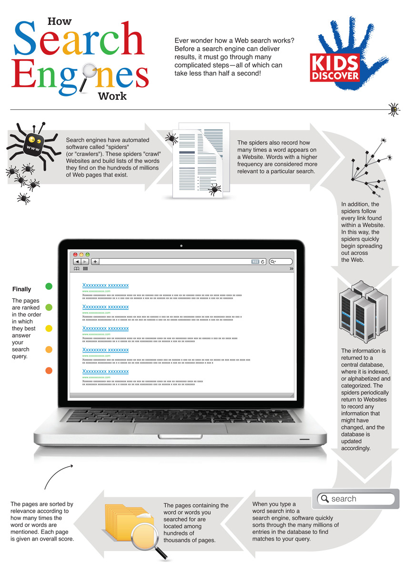

Slide 139
Meta Search Engine
Known As : Multi Threaded Engine
Definition: A Search Engine that queries other search engines and then combines the results that are received from all.
Meta-search engines do not crawl the Web or maintain a database of web pages.
Instead, they act as a middle agent, passing on the query to the major engines and then returning the results.
In effect, the user is not using just one search engine but a combination of many search engines at once to optimize Web searching.

Slide 140
List Of Meta Search Engine
Meta Search Engine
Dogpile
Yippi
Excite
Blingo
DeeperWeb

Slide 141
How Meta Search Engine Works?
Meta search engines create what is known as a virtual database.
They do not compile a physical database or catalogue of the web.
Instead, they take a user's request, pass it to several other heterogeneous databases and then compile the results in a homogeneous manner based on a specific algorithm.

Slide 142
Difference
META SEARCH ENGINE | SEARCH ENGINE
A meta-search engine is a search tool that sends user requests to several other search engines and/or databases and aggregates the results into a single list or displays them according to their source. | A search engine is a search tool that usually have their own database of sites they crawl and list in their database
Meta Search Engines usually do not have their own database of crawled sites, they search the databases of real search engines. | Search engine usually have their own database of sites.
For Example: dogpile, excite | For example: Google, bing

Slide 143
Usenet
Definition: Usenet is a worldwide-distributed discussion system OR worldwide bulletin board system that can be accessed through the Internet or through many online services.
The USENET contains more than 14,000 forums, called newsgroups, that cover every imaginable interest group. It is used daily by millions of people around the world.
Function: The function of Usenet is to provide a network where any user can freely post information which is then rapidly distributed, allowing any other user to access such information as easily as possible.

Slide 144
Usenet
It consists of a set of "newsgroups" with names that are classified hierarchically by subject.
"Articles" or "messages" are "posted" to these newsgroups by people on computers with the appropriate software -- these articles are then broadcast to other interconnected computer systems via a wide variety of networks.
Some newsgroups are "moderated"; in these newsgroups, the articles are first sent to a moderator for approval before appearing in the newsgroup.

Slide 145
Usenet
Usenet is one of the oldest computer networks, having been conceived in 1979 and implemented over a decade before the World Wide Web.
Usenet is a distributed network, which means that it is not controlled by any single source.
Usenet is public. Every participant in Usenet is both reader and contributor

Slide 146
Usenet
Difference between USENET and NEWSGROUP
NEWSGROUP are storehouses of information, while USENET is the network that hosts these groups.

Slide 147
NewsGroup
Also known as “Forum”.
A newsgroup is an Internet-based discussion about a particular topic.
These topics range from sports, cars, investing, teen problems, and some stuff you probably don't want to know about.
Newsgroup is a repository or database usually within the Usenet system, for messages posted from many users in different locations.
Users post messages to a news server which then sends them to a bunch of other participating servers.

Slide 148
NewsGroup
Then other users can access the newsgroup and read the postings.
The groups can be either "moderated," where a person or group decides which postings will become part of the discussion, or "unmoderated," where everything posted is included in the discussion.
To participate in a newsgroup, you must subscribe to it.
The articles that users post to Usenet are organized into topical categories called newsgroups, which are themselves logically organized into hierarchies of subjects.
Newsgroups are often arranged into hierarchies.

Slide 149
NewsGroup
Newsgroups ideal for asking and answering questions and for holding the thread of a discussion.
The term top-level hierarchy refers to the hierarchy defined by the prefix before the first dot.
For Example, newsgroup rec.arts.sf.starwars.games would be in the rec.* top-level Usenet hierarchy, where the asterisk (*) is defined as a wildcard character.
There were seven original major hierarchies of Usenet newsgroups, known as the "Big 7":

Slide 150
comp.* | Discussion of computer-related topics
news.* | Discussion of Usenet itself
sci.* | Discussion of scientific subjects
rec.* | Discussion of recreational activities (e.g. games and hobbies)
soc.* | Socialising and discussion of social issues.
talk.* | Discussion of contentious issues such as religion and politics.
misc.* | Miscellaneous discussion—anything which does not fit in the other hierarchies.

Slide 151
BBS
Full Form: Bulletin Board System
Computerized information message-passing source.
Similar to a physical message board (Notice Board). It allows users to leave message for others to read or pass on.
It is a computer system running software that allows users to connect and log into the system using a terminal program.
Once logged in, a user can perform functions such as uploading and downloading software and data, reading news and bulletins, and exchanging messages with other users, either through email, public message boards, and sometimes via direct chatting.

Slide 152
BBS
It is a communication tool similar to an intranet that provides messaging (i.e. email) plus online discussion forums via folders, as well as an individual and group calendar function.
The BBS became the primary kind of online community through the 1980s and early 1990s, before the World Wide Web arrived.
The BBS interface was text-based. Although recent Web-based versions have a graphical, interactive user interface.
The BBS is often free, although some charge a membership or use fee.

Slide 153
Telnet
TELNET means TELecommunication NETwork
Telnet is a simple, text-based program that allows you to connect to remote computer on the Internet using a username and password.
Provides capability to log onto a remote computer. Hense it is also known as remote login.
To use Telnet to access a device you have to actually have access permission.
This features allows PC’s to communicate successfully with remote pc, help user to tap into internet computers and access public files.
Telnet uses TCP port 23

Slide 154
Continue…..
Telnet session is established by using telnet client software.
The user request session to be established with remote host by providing its host name of IP Address.
The telnet client software locates the host over the internet and establish a remote login session to that host.
The only potensial down side is you must know the computer you are logged onto and the remote computer must also grant you access.
When you connect, your computer acts as if your keyboard is attached to the remote computer.

Slide 155
TelNet
When you type any command, it is executed on the remote computer.
You can observer on your monitor what is taking place on the remote computer when telnet session is going on.
The computer on which you are working by sitting in front of it is called local computer. The telnet connection is to be initialized from this machine.
The machine being connected to, which grant the connection is referred to as the remote computer. It is also known as telnet server.

Slide 156
Characteristics
Bidirectional: That means Telnet is not one-way; it can be used to send and receive information.
Interactive: That means Telnet basically expects a live user on one end of the line. Telnet is not usually used for computers to talk autonomously with each other, but was built from the ground up to be human-readable.
Text-oriented: Telnet is a text-only protocol; you won’t see graphics or fancy images while working with Telnet, nor will you be able to transfer files with Telnet.

Slide 157
PING
Full Name: Packet Internet Gropher.
It is a command line computer network administration utility.
Use: To test the ability of the source computer to reach a specified destination computer.
The ping command is usually used as a simple way verify that a computer can communicate over the network with another computer or network device.
Ping is installed by default on Windows, Apple and Linux/Unix operating systems.

Slide 158
PING
It uses the ICMP protocol which has been created to check IP connectivity and get information about other machines in an IP network.
The ping command operates by sending Internet Control Message Protocol (ICMP) Echo Request messages to the destination computer and waiting for a response.
How many of those responses are returned, and how long it takes for them to return, are the two major pieces of information that the ping command provides.

Slide 159
PING
Switch | Discription
-t | Using this option will ping the target until you force it to stop using ctrl+c.
-n count | This option sets the number of ICMP Echo Request messages to send. If you execute the ping command without this option, four requests will be sent.
-R | This option tells the ping command to trace the round trip path.
target | Give IP address or host name with which we want to check connectivity.
ping [-t] [-n count] [-R] target
Explanation:

Slide 160
PING
Example : ping -t google.com
In this example, I force the ping command continue to ping google.com indefinitely with the -t option.
interrupted the ping manually with Ctrl-C after seven replies.

Slide 161
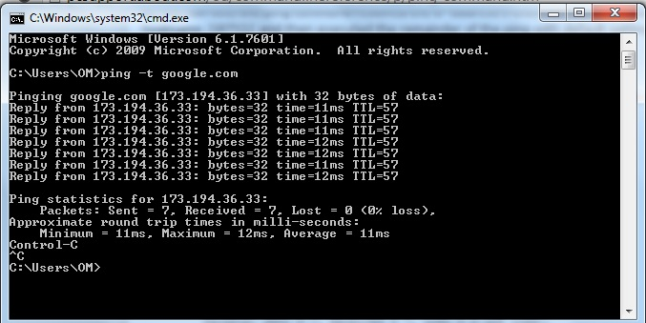
PING EXAMPLE

Slide 162
Analysis | Explanation
Host Reachability | Seven ICMP packets have been sent and four received. This result indicates you that the host is alive at the ICMP level.
IP Address | google.com is a host name but its ip address is 173.194.36.33 .
Time to Live (TTL) | Gives you an indication of the number of routers between the source and destination.
Time | The time taken for a packet to reach the destination and come back. This measure is called the RTT (Round Trip Time) or "response time" and is displayed in milliseconds. The response time will affect network applications performance. High response times will lead to poor performance..

Slide 163
PING: Advantage / Usefuln
PING command is used
  To know hostname and IP Address.
  To know the traffic on the network from the time statistics.
  To know destination PC is alive or not.
  To know the Round Trip Time.

Slide 164
PING EXAMPLE
Pinging SERVER [fe80::fd1a:3327:2937:7df3%10] with 32 bytes of data:
Reply from fe80::fd1a:3327:2937:7df3%10: time=1ms
Reply from fe80::fd1a:3327:2937:7df3%10: time<1ms
Reply from fe80::fd1a:3327:2937:7df3%10: time<1ms
Reply from fe80::fd1a:3327:2937:7df3%10: time<1ms
Reply from fe80::fd1a:3327:2937:7df3%10: time<1ms
Reply from fe80::fd1a:3327:2937:7df3%10: time<1ms
Reply from fe80::fd1a:3327:2937:7df3%10: time<1ms
Ping statistics for fe80::fd1a:3327:2937:7df3%10:
Packets: Sent = 7, Received = 7, Lost = 0 (0% loss),
Approximate round trip times in milli-seconds: Minimum = 0ms, Maximum = 1ms, Average = 0ms

Slide 165
BLOG
Blog is a frequently updated online personal journal or diary.
It is a place to express yourself to the world. A place to share your thoughts and your passions.
Really, it’s anything you want it to be. For our purposes we’ll say that a blog is your own website that you are going to update on an ongoing basis.
A blog is a type of website which has posts (or entries) appearing in reverse chronological order.
A blog originally came from the word “web log”.

Slide 166
BLOG
A blog is typically updated frequently and regularly.
Blogs typically have an area for people to comment or respond to the blog post.
The significance of the blog is that it is dynamic. That is that it can be updated and it allows the visitor to communicate through the comment section attached to each individual post.
Blogs may also have other areas of content and links to other websites
Blogs have a history or an archive of previous blog posts.

Slide 167
CHARACTERISTICS OF BLOG
A blog has some form of navigation, usually menus
A blog’s layout contains a header, footer and content. Usually there is at least one sidebar running beside the content.
Categories of posts
That readers can access the archives, previous posts
That a post can contain text and images, Audio etc
That posts can contain links to other posts, both within blog and to the entire web
Should contain a contact page and form

Slide 168
Types Of Blog
Blogger: A blogger is someone who blogs, or writes content for a blog.
Blogging is the act of writing a post for a blog.
There are many different types of blogs, differing not only in the type of content, but also in the way that content is delivered or written.
  Personal Blogging
  Microblogging
  Organizational Blogging
  By Genre
  Reverse Blog

Slide 169
Types Of Blog
Personal Blogging : It is an ongoing diary or commentary written by an individual.
Microblogging: It is the practice of posting small pieces of digital content—which could be text, pictures, links, short videos, or other media. Examples of these include Twitter, Facebook, Tumblr
Organizational Blog: A blog can be private, or it can be for business purposes.
  Blogs used internally to enhance the communication and culture in a organization or externally for marketing or public relation purposes are called corporate or organizational blog.

Slide 170
Types Of Blog
By Genre: Some blogs focus on a particular subject, such as political blog, health blog, travel blog, music blog ,gardening blogs, house blogs.
Reverse Blog: A Reverse Blog is composed by its users rather than a single blogger.
  This system has the characteristics to writing of several authors. These can be written by several contributing authors on a topic, or opened up for anyone to write.

Slide 171
Blog is about communication - Justify
A blog is a very effective way of reaching out and communicate with a sizable audience from these billions.
You may want them to just to come and read your personal thoughts; you may want to inform people; you may want to tell them about your campaign; you may want to attract potential customers to your services or business; you may want to sell them something.
In all these cases you are communicating and in most cases you are trying to get the visitor to take some form of action, even if it is only to click a link to read another post on your site.

Slide 172
Blog Vs Website
Two features of a blog that set it apart from a traditional website.
Blogs are updated frequently. Whether it's a mommy blog in which a woman shares adventures in parenting, a food blog sharing new recipes, or a business providing updates to its services, blogs have new content added several times a week.
Blogs allow for reader engagement. Blogs are often included in social media because of the ability for readers to comment and have a discussion with the blogger and others who read the blog makes it social.

